Slide 1
“The prudent heir takes careful inventory of his legacies.”
Notes:
That rings true to me, even if I’m not expecting any legacies on the scale of what this fellow received from his parents.
But for the purposes of this discussion we are not talking about stocks and family fortunes but about an inventory of tsunami-related materials. The various NTHMP organizations have a lot of materials that can indeed serve as legacies for other programs.

Slide 2
 |  | Combined Total Size (GB) | 1137.4
Item |  |  |  | CA | OR | WA | AK_EM | AK_UAF | AK_ATEP | HI_PTM | HI_SCD | ITIC | PR_PRSN | PR_PREMA | PR_CTWP | PTWC | WCATWC
Education, training, facilitation materials
 | End-user educational materials
 |  | Broadcaster Tsunami emergency guidebook |  |  | Yes | Yes |  |  |  |  |  |  | Yes |  |  |  | Planned
 |  | Children’s books, e.g., “Heidi and the Tsunami" |  |  |  | Yes | Yes |  |  |  |  |  | Yes |  |  |  | Yes
 |  | Community Emergency Response Teams (CERT) training materials |  |  |  |  |  |  |  |  |  |  |  | Yes
 |  | Construction guides to mitigate tsunami damage |  | Planned | Yes |  |  |  |  | Yes
 |  | Educational posters |  | Yes |  | Yes | Yes | Yes |  |  |  |  | Yes |  |  |  | Yes
 |  | Educational toolkits |  | Yes |  | Yes |  |  |  |  |  |  | Yes |  |  |  | Yes
 |  | Hotel/motel room tent cards, hazard cards |  |  | Yes | Yes | Yes |  |  | Yes | Yes |  | Yes |  |  |  | Yes?
 |  | Hotel/motel disaster response guidebook |  |  | Yes | Yes
 |  | Legislative opinions |  |  |  |  |  |  |  |  |  |  |  | Yes
 |  | Media coverage of tsunami-related activities |  | Yes |  | Yes | Yes |  |  |  |  |  |  |  |  |  | Yes
 |  | Media relations guidelines (talking points, etc) |  | Yes |  | Yes |  |  |  |  |  |  | Yes | Yes |  |  | Yes
 |  | Media toolkits |  |  |  | Yes |  |  |  |  |  |  | Yes
 |  | Presentations (Posters) |  | Yes |  | Yes | Yes |  |  |  |  |  | Yes |  | Yes |  | Yes
 |  | Presentations (PowerPoint) |  | Yes |  | Yes | Yes | Yes |  |  | Yes |  | Yes | Yes | Yes | Yes | Yes
 |  | Press releases |  | Yes |  | Yes | Yes |  |  |  | Yes |  | Yes | Yes | Yes | Yes | Yes
 |  | Public outreach materials (businesses, schools, gov. agencies, residents) |  | Yes | Yes | Yes | Yes |  |  | Yes | Yes |  | Yes | Yes |  |  | Yes
 |  | Textbook inserts providing tsunami information | None
 |  | TsunamiReady brochures |  | Yes |  | Yes | Yes |  |  |  |  |  |  |  |  |  | ???
 |  | Vertical evacuation guide |  |  |  | Yes |  |  |  |  |  |  | Yes
 |  | Videos, DVDs on Tsunami preparedness |  | Yes |  | Yes | Yes | Yes |  |  | Yes |  | Yes |  |  |  | Yes
Notes:
This is how Scott and I have summarized the data we collected. Across the top of this spreadsheet we have arrayed the organizations we visited and the list down the left side comprises the materials themselves. This will look familiar to the people we sent draft inventories to, except that this version consolidates the information from all the respondents into a single spreadsheet.

Slide 3
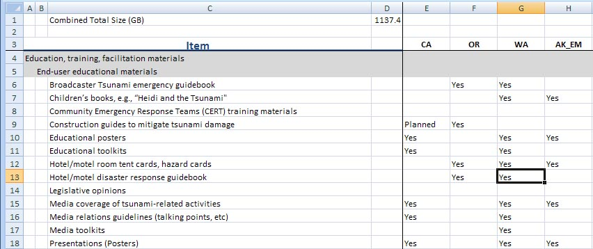
Notes:
How does this work? If we zoom in a bit we can see the “yeses” that indicate what organizations have what materials. Now, if we double-click the “yes” showing that Washington has a hotel disaster response guidebook, a pop-up appears with more information.

Slide 4
Common inventory items
Peer reviewed documents
Post-tsunami survey forms
Course curricula
Functional exercise scripts
Public outreach materials
Press releases
PowerPoint presentations
Notes:
This is a selection of the kinds of data objects that many respondents reported. It’s a little surprising to me that post-tsunami survey forms are common, but it’s to be expected, perhaps, that public outreach materials are common. But the most common of all, proving that I should have bought Microsoft stock a long-time ago, is… PowerPoint presentations.

Slide 5
Uncommon inventory items
Construction guides
Hotel disaster response guides
Broadcaster training scripts
Hotelier training scripts
Map Your Neighborhood training scripts
School evacuation drill guidelines
Actual inundation maps
Notes:
These items, on the other hand, are uncommon. These might be good candidates for sharing with other organizations. Or, maybe it means that there isn’t much demand for these in the first place.

Slide 6
Nobody has…
Textbook inserts about tsunamis
Information about the equipment used for disseminating tsunami warnings
Prehistoric landscape reconstruction from geologic data
Reef profiles
Notes:
We had these items in the inventory list but nobody reports having them. Again, does this mean there is no perceived need for these?

Slide 7
What we know about objects
Notes:
Let’s look at the inventory spreadsheet in a little more detail. In particular, let’s go to one of the sheets that gives details for a particular organization. This is perhaps typical of the kinds of information we have for the objects we inventoried.
For row 21, we have titles, data format information, and a size (although it is unclear whether the format information applies to all the listed titles and it is unclear whether the size is for all the items together).
Row 19, is just a summary list, without formats or sizes.
Row 25, we have a title and we might be able to estimate a data size from the supplied length.
All this information is metadata, the information that we have about data objects. We did not collect objects (mostly) but only the descriptive information about objects that might be placed in the repository.
It would be nice to have a denser matrix of information, but gathering that information is usually not at the top of potential contributors’ list of priorities, as we might illustrate by our own experiences collecting information.

Slide 8
The inventory experience
We contacted and interviewed 25 people
September 30th: Draft inventories sent to each
November 3rd: Reviews completed by 14
Notes:
The bare facts are that we interviewed 25 people over the course of the summer and sent each of them the draft inventories we compiled for them. We asked each to review and get back to us with corrections and with details about sizes and formats, in particular.
Here are the results.

Slide 9
Notes:
This chart, along the bottom, indicates how many times we have contacted respondents, with the first contact being the request to review the inventory. At the left side of the chart we see that 2 respondents returned their comments as soon as we asked them to. In the middle of the chart, we see that 6 respondents replied after we had followed up twice with either emails or phone calls. And on the right side of the chart we see that one respondent replied after 6 followups.
I want to be very clear that this is not to be construed as criticism. There are many perfectly justifiable reasons why responses are delayed, ranging from shutdowns, to training, to vacations, to things that simply have to be higher priority. The point is just to illustrate that collecting metadata has been challenging, and, as I’ll note later, I expect that actually populating the repository will be equally challenging.
That said….ANIMATION

Slide 10
Inventory status
100% of organizations have been visited
100% of meetings have been completed
60% of respondents have provided feedback on the draft inventory for their organizations
Notes:
Here in brief, is the inventory status. If you counted the green squares in the previous chart you could calculate that 60% of the 25 respondents have provided feedback. That’s the 3rd bullet, and the first 2 bullets indicate that we have finished our visits and meetings.
Which brings us around from the inventory to the repository itself.
Scott already discussed the repository requirements that we have drawn from the conversations we had with respondents. Other issues involve the assumptions that govern development, and the development of appropriate metadata types.

Slide 11
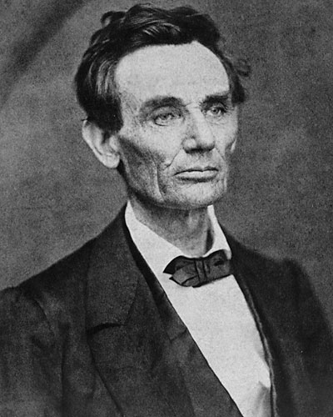
“I never had a policy; I have just tried to do my very best each and every day.”
Notes:
President Lincoln might have navigated the Civil War without a policy to guide him, but most of those who have evaluated the repository development of the last 10 years, agree that a repository policy is a good thing to have.

Slide 12
What a policy tells us
Content policy
Submissions policy
Data policy
Metadata policy
Preservation policy
Privacy policy
Notes:
Content: what kind of content can be deposited
Submissions: who can deposit materials and copyright issues
Data: how the data can be accessed, used, and reused
Metadata: how the metadata can be accessed, used, and reused.
Preservation: migration, backing up, and withdrawing objects
Privacy: how information about users is used

Slide 13
Policy assumptions and…
Only digital
Only limited, static support for web pages
All objects available to the public
Metadata only for objects in the repository
Web-based
No special software to run content
Notes:
In thinking about a design for the repository, we have implicitly operated with a very basic set of policies.
Put first 4 bullets up
And we have made some other assumptions that might not properly be classified as policies because they have more to do with how the repository is implemented.
Put up last 2 bullets.
But there are many more policy issues that need to be resolved, including these.

Slide 14
Some policy issues
What subjects are appropriate?
Who can make deposits?
Can access to any data objects be restricted?
Can we accept multiple versions of objects?
How much aid do repository personnel provide?
Should contributing be mandatory?
Are metadata freely available to anyone (even for commercial re-sale)? Must a link to the original metadata be given?
Notes:
I don’t want to take the time to discuss these now except to point out that some of them, such as restricting access to objects, affects how the repository is implemented.
The concept of metadata has crept into this presentation a time or two but I’ve glossed over it. But deciding on what metadata requirements to implement is a critical aspect of repository development. Several of our respondents have indicated, for example, that being able to designate a target audience is important.

Slide 15
“I love an audience. I work better with an audience.”
Notes:
And Lucy apparently agrees with that assessment.

Slide 16
Audiences
Broadcasters
Children
Construction industry
Emergency managers
Focus groups
Hoteliers
Legislators
Local government
Mariners
Media
Modelers
Public, general
Researchers
Warning center personnel
Notes:
This is the set of possible audiences that I pulled out of our inventory data, although other variations are certainly possible. Maybe we should divide Children into elementary school and high school, for example. Maybe Broadcasters and Media should be combined. And so on.

Slide 17
Publication types
Animations/videos
Books
Brochures
…
Survey forms
Talking points
Training scripts
Notes:
Another type of metadata that seems reasonable is to specify the type of the data. There are too many types to list here but you can see them on the lists that were sent out earlier.

Slide 18
Keywords
All Hazard Alert Broadcasting (AHAB)
Best practices
Boundary conditions
…
Warning center guidelines and protocols
Warning centers
Workgroups
Notes:
The set of keywords is important. Having a larger set might make it easier for a searcher to zero in on a topic of interest, but that has to be balanced with the fact that having more keywords is probably more work for contributors.

Slide 19
Other metadata
Audiences
Publication types
Keywords
Contributor
Coverage
Creator
Date
Description
Format
Identifier
Language
Publisher
Relations
Rights
Source
Title
Notes:
So far I’ve talked about three kinds of metadata. But that isn’t enough to meet the needs of users. They obviously need a description of data objects, for example.
Defining an appropriate set of metadata is a challenge that all repositories face, however, and, to address it, implementers have come up with a basic set of core metadata, flexible enough to allow individual repositories to customize it, but with enough consistency to give humans and software agents a reasonable expectation of the kind of data encompassed by each category. One such set of metadata is referred to as Dublin Core.
Merging the Dublin Core categories with the categories we have already mentioned, gives a list something like this.
ANIMATE the other items onscreen
I have already alluded to the fact that convincing people to contribute material to the repository is probably more difficult than implementing the repository in the first place.

Slide 20
“Good intentions aren’t good enough!”
Notes:
This seems an accurate observation. So I’m happy enough to give President Bush this plug—maybe it will help his book sales.

Slide 21
“It is surprising and disappointing that Institutional Repository collections have generally grown more slowly than proponents had anticipated. The phenomenon is worldwide.”
(Institutional Repositories: A Review of Content Recruitment Strategies)
Notes:
This observation particularly refers to institutional repositories but I think it is generally applicable and likely to effect recruitment to the NTHMP repository too.
So how do we get contributions?

Slide 22
Why contribute?
We asked “What will induce you to contribute products to the repository?”
Score 1 to 5 where 5 is “very important”
Notes:
To begin to address this issue, we asked our respondents what they thought.

Slide 23
Will contribute if…
It is easy for other people to find and use the data objects (Average score: 4.6 out of 5.0).
The repository reduces the workload for contributors (4.4).
Data objects have unique and persistent URLs (4.1).
The repository enables self-deposit of content (4.1).
Notes:
These were the most important inducers. The 1st and 3rd bullets have to do with making it easy for users to find objects in the repository. The 2nd and 4th have to do with making it easy to contribute objects to the repository.
If we want people to contribute, “make it easy to put objects into the repository, and make it easy for users to get objects out.”
This might seem self-evident, but our respondents said that some other things that I thought might encourage contributions did not seem important to them.

Slide 24
Don’t care if…
The repository provides a personal page for individual contributors (2.0)
Someone else goes first (1.7).
Notes:
Respondents are not concerned about tooting their own horns.
And the folks we interviewed are all brave enough to go first (or perhaps that simply means that ignorance really is bliss).
But I’d like to specifically mention one response that got a middling score of 3.5, whether it should be mandatory to contribute to the repository.

Slide 25
But, contributors disagree about…
Instituting a mandatory deposit policy (3.5).
Coloring outside the lines
Notes:
Two clusters with strong feelings.
Answers were supposed to run between 1 and 5 but for one respondent, a score of one was not sufficient to indicate what a bad idea this is.

Slide 26
I’ve talked about
What the inventory looks like
Status of the inventory
Policy issues
Metadata (Dublin core)
The challenge of populating the repository
Notes:
To this point, I’ve talked about…
But it is hard to get a feeling for what the repository might look like from these important, but somewhat theoretical discussions. So lets try to get a bit more concrete.

Slide 27
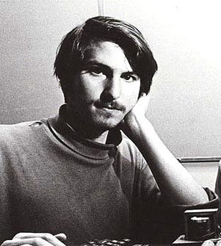
“Design is not just what it looks like and feels like. Design is how it works.”
Notes:
If you don’t recognize this fellow there are some clues in the transformer and keyboard at the bottom of the picture, which, I can add, dates from 1975.
Steve Jobs
If you look really close you can see that the shoulder seam in his turtleneck is ripped open. Is that a badge of nerdity or what?

Slide 28
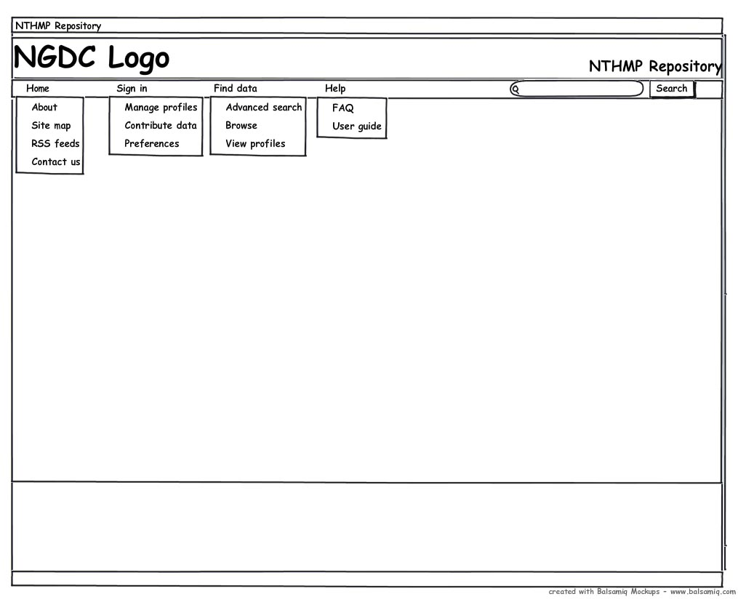
Notes:
So here’s a sketch of a possible opening screen for repository GUI. Not a design, just a sketch of one possibility.
Speaking of design, I prefer simplicity over complexity. Here the menu bar only has 4 main entries and includes a simple search, right on the first (and every page). The menu pull-down entries are short.
If we select Find data—Advanced search we move to…

Slide 29
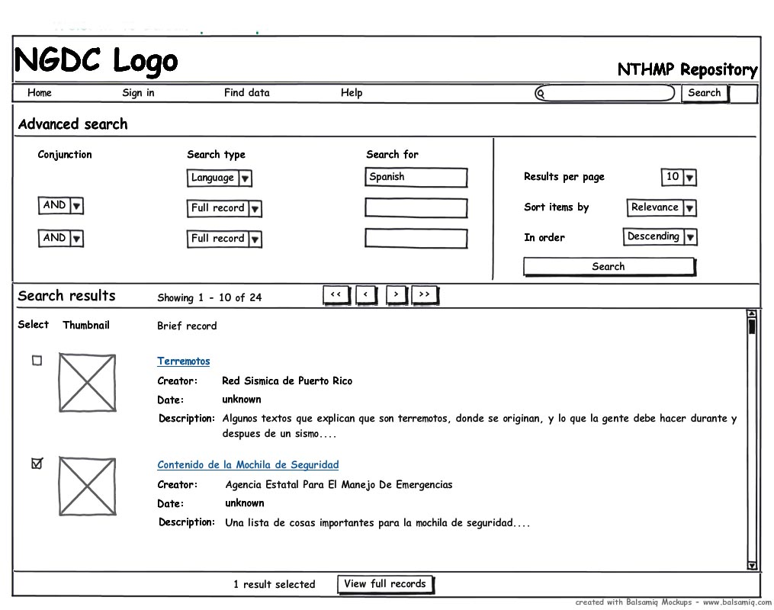
Notes:
On this page, the searching takes place in the upper left-hand corner—in this case, I am searching the “Language” metadata field for “Spanish.” The results, in summary form, appear below. The thumbnails sketches apply to formats such as PDF and give a small, overall view of the document.
One requirement we have is to be able to operate on a “shopping cart” approach, meaning that we can select which items to affect. On this page, we’ve selected “Contenido de la Mochila…”
Now to see a full record, we click “View full records.”

Slide 30
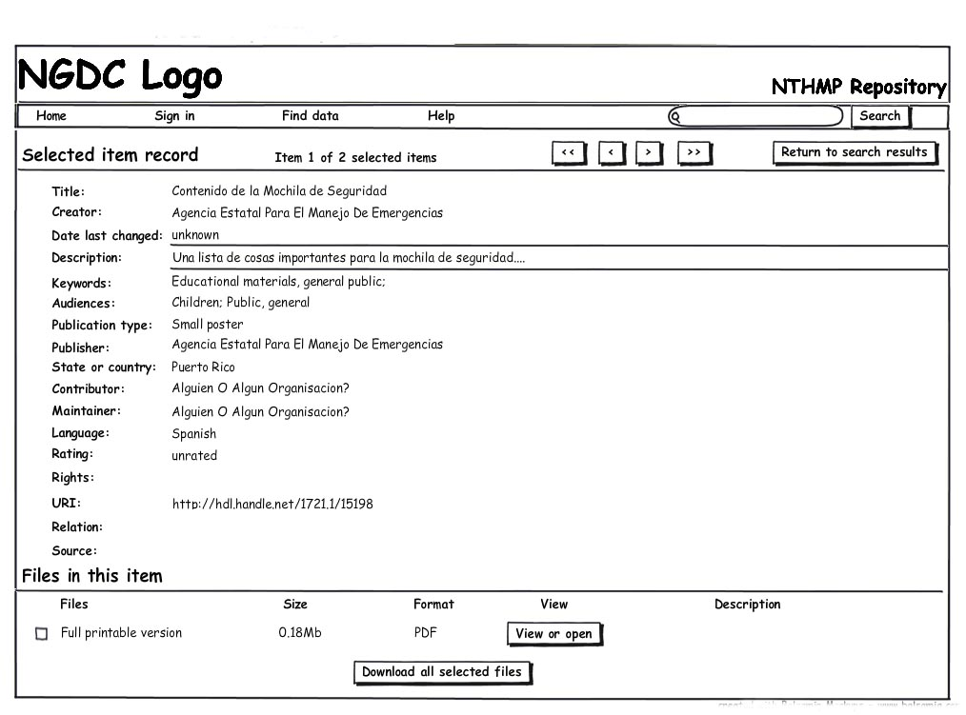
Notes:
The first thing to note on this page is that all the metadata is displayed.
The second thing to note is that the files that comprise a data object are exposed. This reflects that ability to handle packages or bundles of information, which is one of the requirements we have developed.
So now we conclude my presentation and move instead to your participation.

Slide 31
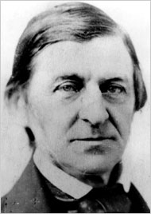
“I hate quotations. Tell me what you know.”
Notes:
Ralph Waldo Emerson

Slide 32
Questions (for you)
Will users/downloaders need to log in?
How long can creating metadata take?
Who will vet proposed contributions?
Who is allowed to contribute?
What about georeferencing?
Can access to any object be restricted?
Are multiple versions supported?

