Slide 1
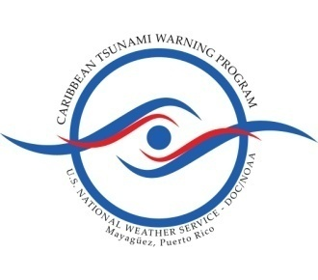
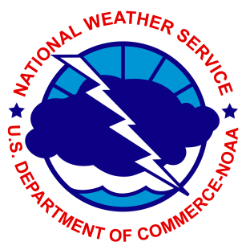
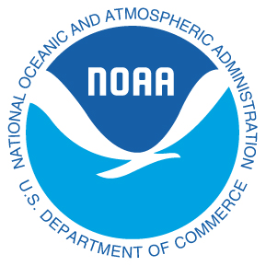
United States Virgin Islands Update
NTHMP Meeting
February 9, 2012
San Diego
Presented on behalf of the USVI by:
Christa G. von Hillebrandt-Andrade
NOAA NWS Caribbean Tsunami Warning Program
Vice President UNESCO ICG CARIBE EWS

Slide 2
Caribbean risk to life from tsunamis has increased dramatically due to coastal population & tourism growth! For example: Port at Charlotte Amalie Bay, St. Thomas, USVI .
20 Foot tsunami, November 17, 1867
Same bay in St. Thomas today!
30 people lost their lives on November 18, 1867 in a 20 ft tsunami. Today, there can be 25,000+ people at risk around the Bay because of cruise ships. Almost all these people are in the tsunami inundation zone around the bay, docks, beaches and shops.

Slide 3
Charlotte Amalie Harbor, February 1, 2011. 6 Cruise ships with estimated 25,000 (including visitors and crew)

Slide 4
TsunamiReady requirements are based on the resident population in the Hazard Zone
USVI Total Populations (2010 Census)
St. Thomas: 51,634
St. Croix: 50,601
St. John: 4,170
Visitors and Tourists can be up to 25,000 tourists a day

Slide 5
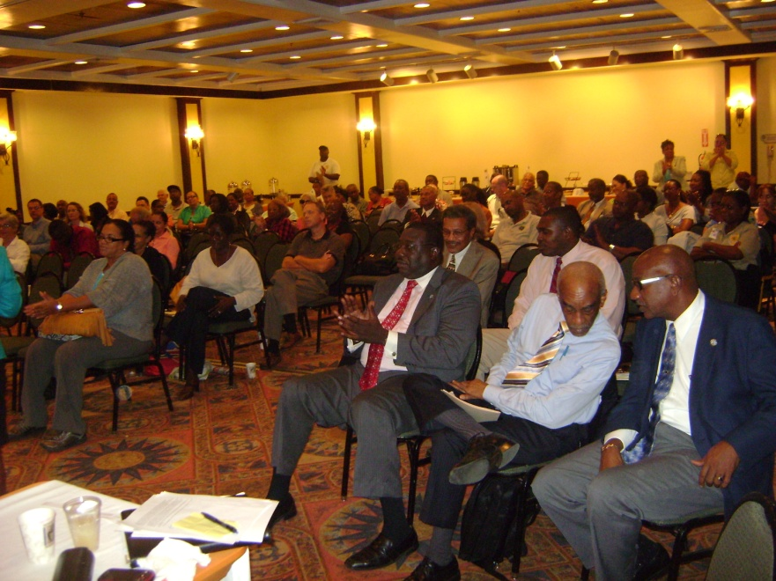
USVI Tsunami Program Update
In August 2009, NTHMP awarded the USVI $42,000. This funding was used to conduct two community workshops and convene the territorial tsunami working groups.

Slide 6
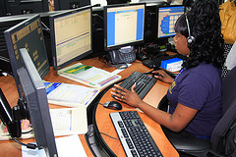
USVI Tsunami Program Update
USVI established state of the technology EOC’s and 911 centers on St. Thomas and St. Croix for 24/7 management and notification capabilities.
In 2010 with FEMA funding, installed the VI Mass Alert and Notification System providing 24/7 messages thru multiple means to its subscribers.

Slide 7
USVI Tsunami Program Update
In 2010-2011 VITEMA utilized a $350,000 federal homeland security grant and 10 sirens were installed on the islands of St. Croix, St. John and St. Thomas to warn the community of a tsunami threat alert. VITEMA has received an additional $350,000 which it will combine with VI PFA funding to purchase 14 additional units ($350,000).
USVI participated in the 2011 LANTEX/CARIBE WAVE exercise and will also be participating in the 2012 LANTEX as well as other tsunami exercises as part of the FEMA Catastrophic planning.

Slide 8
USVI Tsunami Program Update
VITEMA and local researchers have conducted a vigorous education and outreach program in schools, community centers, public venues, media and thru its website.
In 2011 VITEMA purchased with FEMA funding 100 Tsunami signs.
NOAA weather radios have been distributed to schools and government offices.

Slide 9
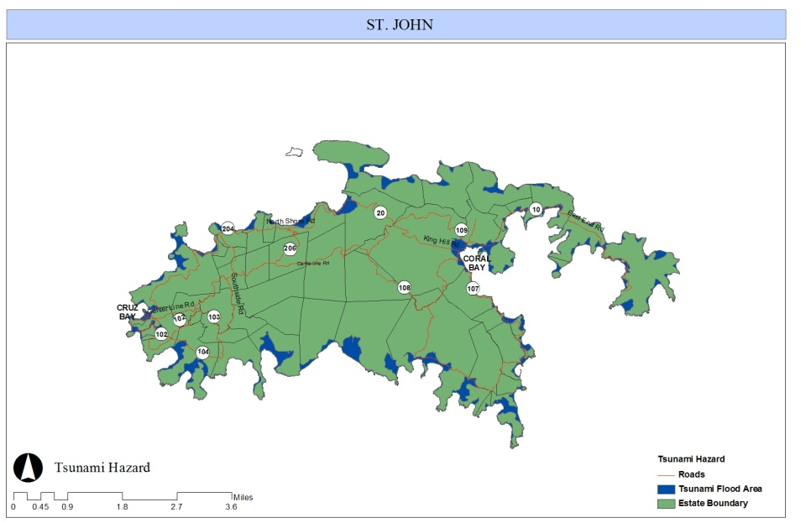
USVI Evacuation Maps
In absence of tsunami modeling 80 feet elevation and 1 mile inland were used as the parameters for establishing the tsunami evacuation zone.

Slide 10
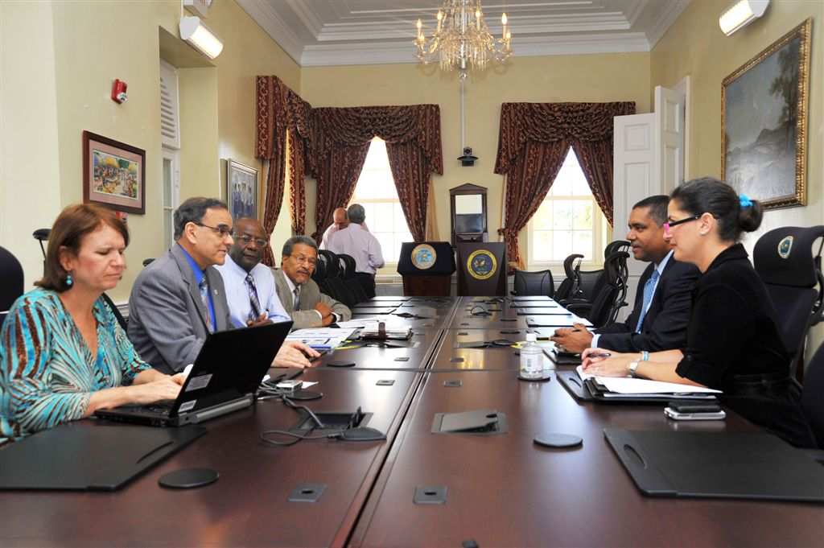
USVI Tsunami Program Update
On January 31, 2012 the Governor of the US Virgin Islands, John P. de Jongh Jr. and the Director of VITEMA, B. Gen. Elton Lewis signed the Tsunami Incident Annex which establishes guidelines for emergency response agencies during a tsunami incident. This project was funded by a $100,000 grant from the VI Public Finance Authority.

Slide 11
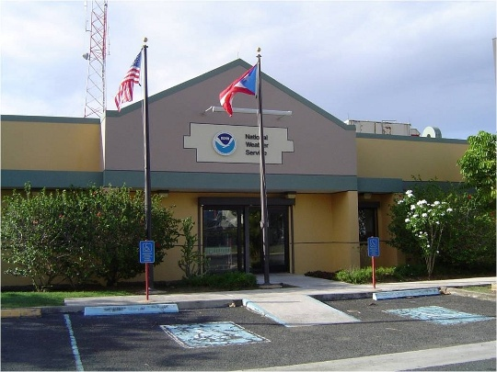
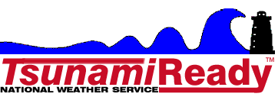
Needs for USVI to Meet TR Requirements
Prepare, print and distribute 6000 tsunami evacuation maps following the NTHMP guidelines for the islands of St. Croix, St. John and St. Thomas ($18,000)
Travel of 2 VITEMA officials to the NWS SJFO and the Caribbean Tsunami Warning Program in Puerto Rico for training on the tsunami warning system procedures ($4,000).

